Slide 1

Time Series Analysis

Slide 2
AGENDA
Why time series
What is time series
Components of time series
When not to use Time series
What is stationary data
How to differ between stationary and non-stationary data

Slide 3
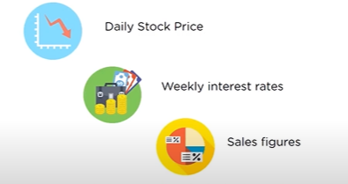
Why Time Series?
Time series is used when we would like to predict something in future.
Time series is also called Time series Forecasting.
Where the outcome is dependent on time.
Back to main

Slide 4
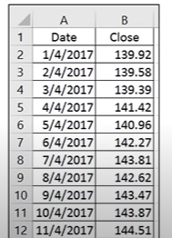
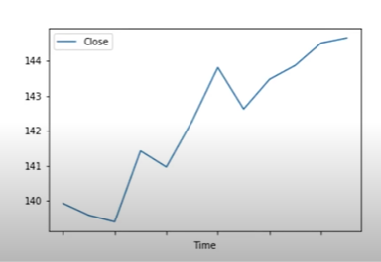
What Is Time Series?
A time series is a sequence of data being records at specific time interval.
These data points (past values) are analyzed to forecast a future.
It is time-dependent.
Example:
Back to main

Slide 5
Components of time series:
There are four main components in time series:
Trend
Seasonality
Cyclicity
Irregularity
Back to main

Slide 6

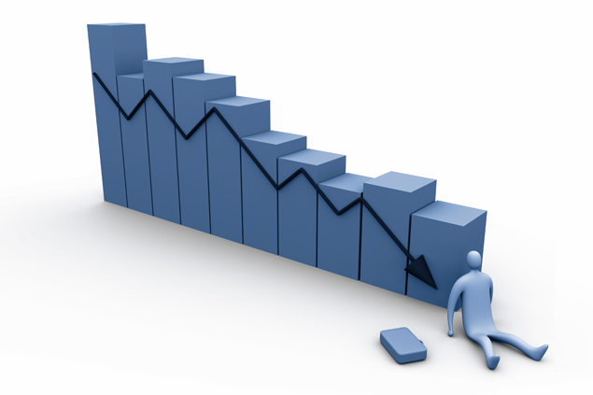
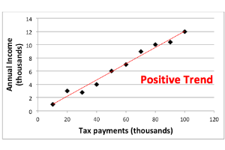
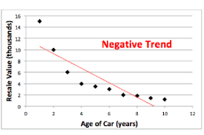
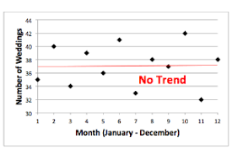
Trend
Trend is the increase and decrease in the series over a period of time. It persists over a long period of time.
Trend can be:
Upward trend
Downward trend
Null trend
Example: Population growth over the year can be seen as an upward trend.

Slide 7
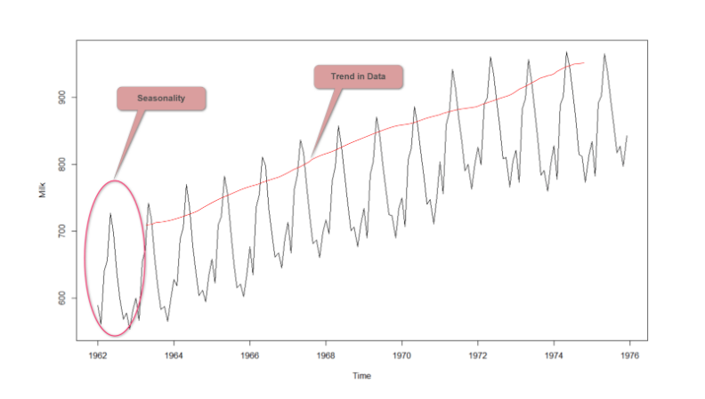
Seasonality
Regular pattern of up and downs fluctuations. It is a short- term variations occurring due to seasonal factors.
Examples
Sales of ice-cream increases during summer seasons.
Sales of warm clothes

Slide 8
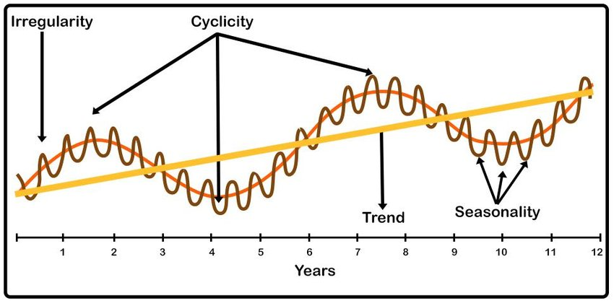
Cyclicity:
It is a medium-term variation caused by circumstances which repeat in irregular interval.
Example:
5 year of economic growth followed by 2 year of economic recession, followed by 7 years of economic growth followed by 1 year of economic recession

Slide 9
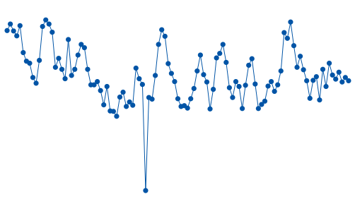
Irregularity
It refers to variation which cause due to unpredictable factors and also don’t repeat in particular patterns.
Example:
Variation caused by incidents like earthquake, war, pandemic etc.

Slide 10
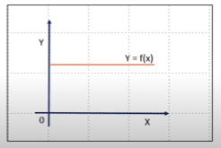
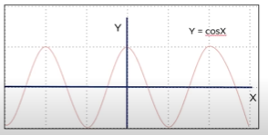
When not to use time series analysis
When the values are constant over period of time.
2. When values can be represented by known fixed functions like cosx, sinx, etc.
Back to main

Slide 11
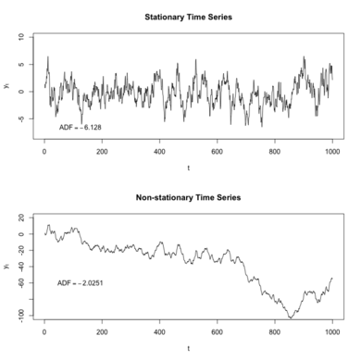
What is stationary data.
Non-stationary data:
If the time series component are present in Time series data it is non-stationary time series data. Raw time series data is non-stationary data
Non-stationary time series has trend and seasonality component which affects the forecasting of time series
Stationary data:
Opposite to Non-Stationary data but stationary data may have seasonality but will not have trend.
Back to main

Slide 12
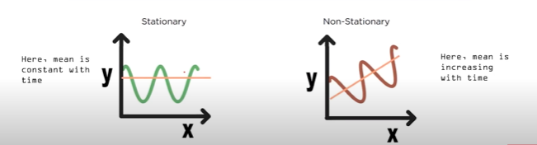
How to differ between stationary and non-stationary data
Stationary of time series depend on three factors:
Mean
Variance
Co-variance
MEAN
Mean of series should be constant with time
Back to main

Slide 13
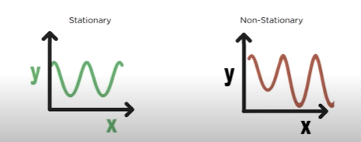
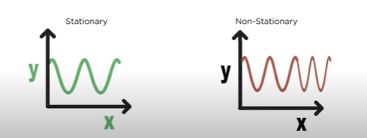
Variance
Variance should not be the function of time
Co-variance
Co-Variance should not be the function of time

Slide 14
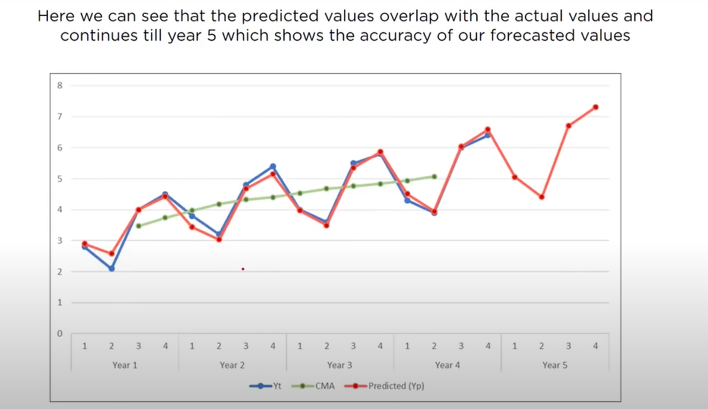
Back to main

